Slide 1

Online Payment Fraud Detection
Machine Learning Project Presentation

Slide 2

Introduction
Online payments have increased rapidly due to digital banking, e-commerce, and UPI transactions.
With this growth, fraudulent transactions have also increased, causing:
Financial losses
Customer trust issues
Business risk
Motivation: To build a Machine Learning model that can automatically detect fraudulent online transactions in real time.

Slide 3
Problem Statement
Fraudulent transactions are rare but highly damaging.
Business Problem:
Detect whether a transaction is:
Legitimate (0)
Fraudulent (1)
Challenges:
Imbalanced dataset (Fraud cases are fewer)
Need high Recall (to catch frauds)
Avoid false positives

Slide 4
Dataset Overview
Dataset Name: online_payment_fraud_realistic.csv
Target Variable:
Preprocessing Steps:
is_fraud (0 = Legit, 1 = Fraud)
Filled missing numerical values (mean)
Filled missing categorical values (mode)
Label Encoding for categorical columns
Standard Scaling
Train-Test Split (80%-20%)
Features Include:
Transaction amount
Payment type
Customer details
Account balance
Time-related features

Slide 5
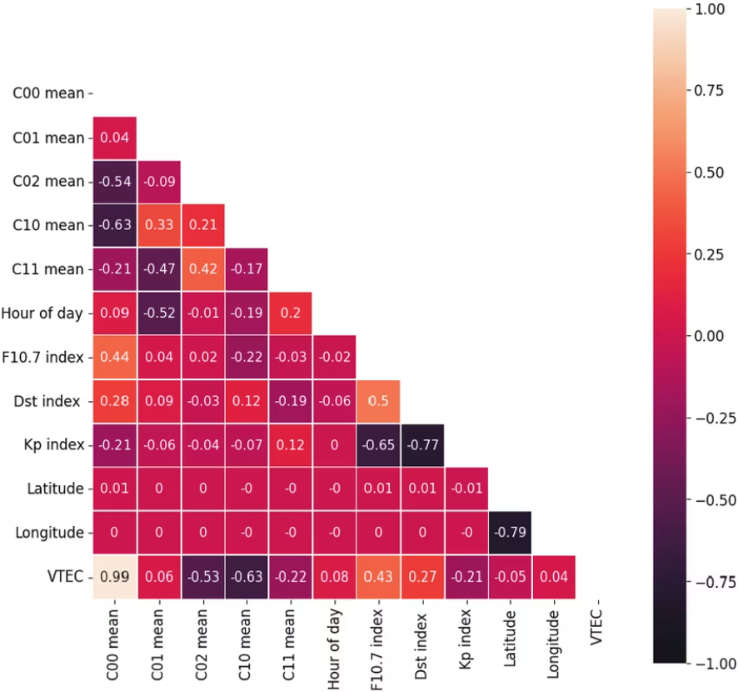
Data Visualisation
Class Distribution: Fraud vs Non-Fraud
Observation: Fraud cases are significantly fewer than normal transactions → Imbalanced dataset.
Correlation Between Features

Slide 6
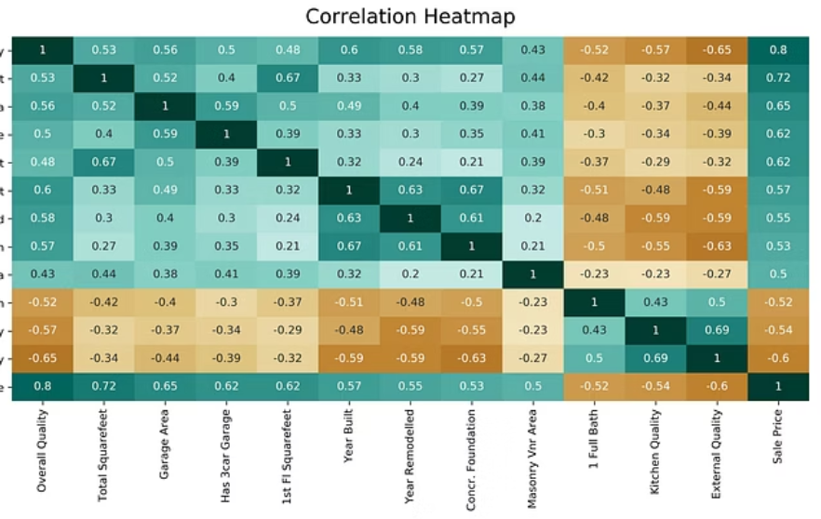

Slide 7
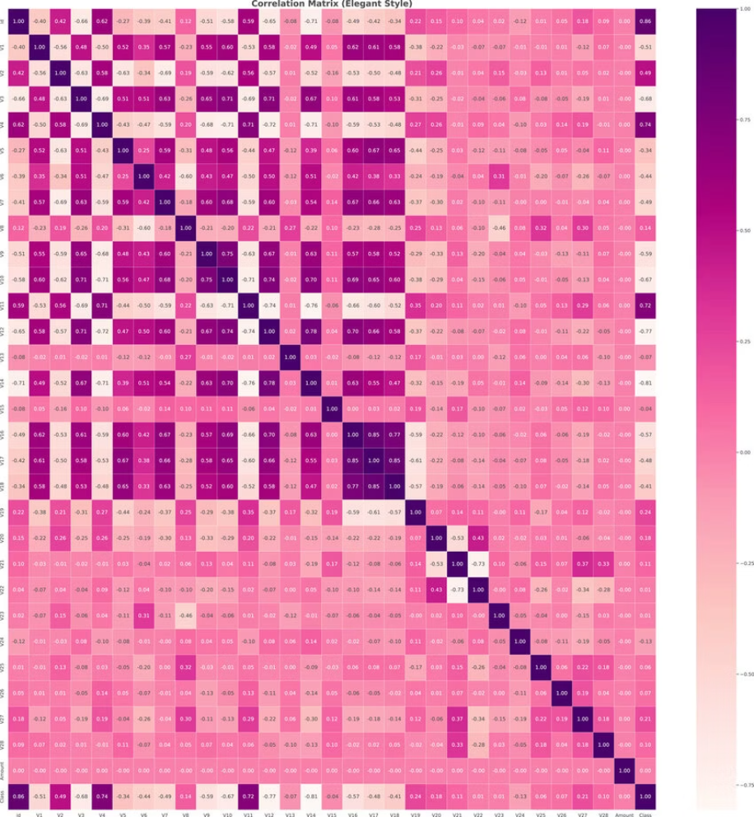
Observation: Some features strongly influence fraud detection. Correlation helps understand important predictors.

Slide 8
Models Used & Results
Algorithms Implemented:
Logistic Regression
Decision Tree
Random Forest
Support Vector Machine (SVM)
Gradient Boosting
Hyperparameter Tuning:
Performance Metrics Used:
Used GridSearchCV
Optimised using F1-score
3-Fold Cross Validation
Accuracy
Precision
Recall
F1-Score
Confusion Matrix
Best Model:
Random Forest Classifier
(example – adjust if different)
High Accuracy
Better Recall for Fraud
Handles imbalance better

Slide 9
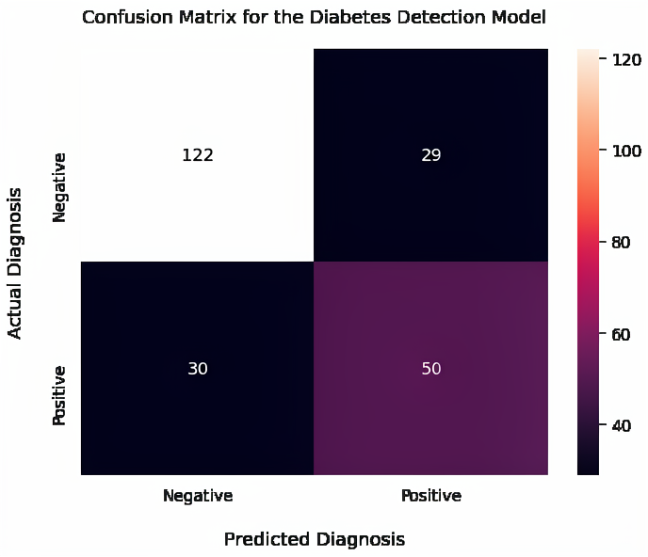
Confusion Matrix Example
Interpretation:
True Positives → Correctly detected fraud
False Negatives → Missed fraud (critical)
False Positives → Wrongly flagged legit transaction

Slide 10
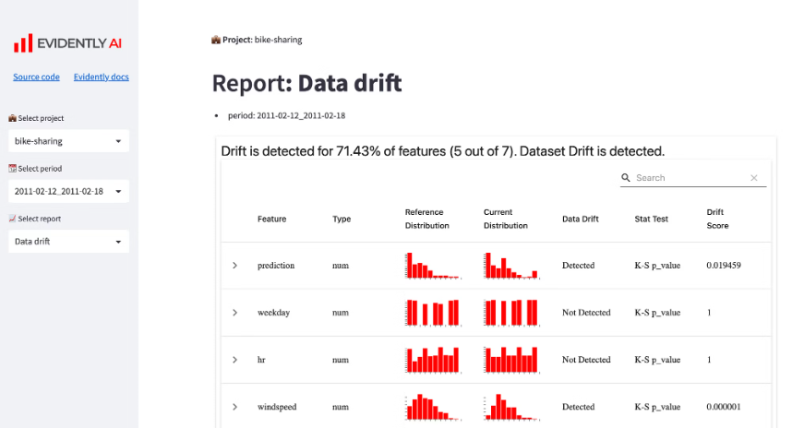
Dashboard Screenshot (Streamlit App)
Your deployed Streamlit Web App includes:
Dataset Preview
Model Accuracy Display
Classification Report
Real-time Fraud Prediction
Fraud Probability Output

Slide 11
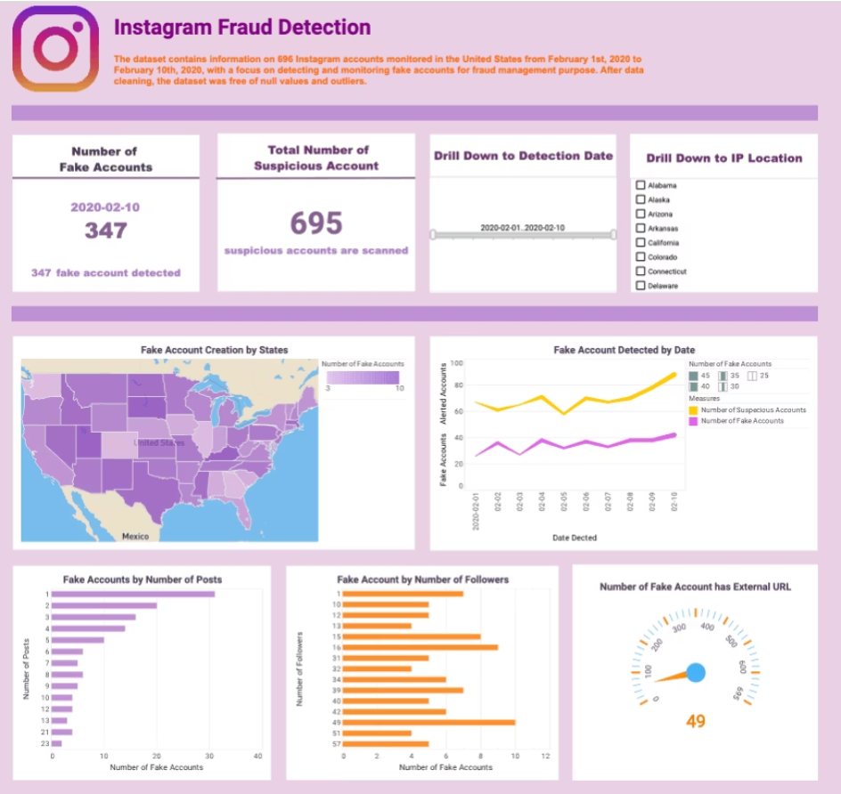

Slide 12

User can input transaction details → Model predicts fraud instantly.

Slide 13





Conclusion
Successfully built and tuned 5 ML models
Identified best-performing model using F1-score
Deployed as Streamlit Web Application
Real-time fraud detection capability
Key Outcome:
Machine Learning can significantly reduce financial fraud losses and improve transaction security.

